Slide 1
Task 2 Testing examples
T-levels Y2s

Slide 2
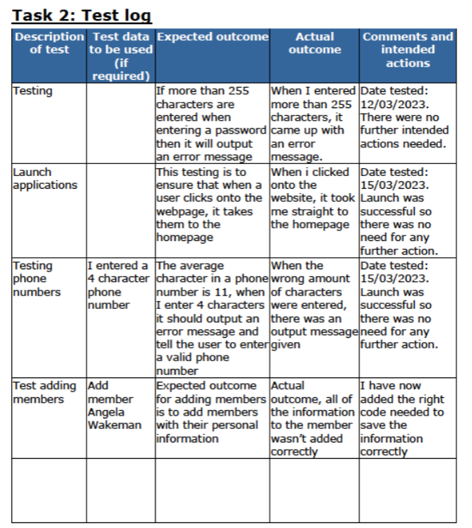
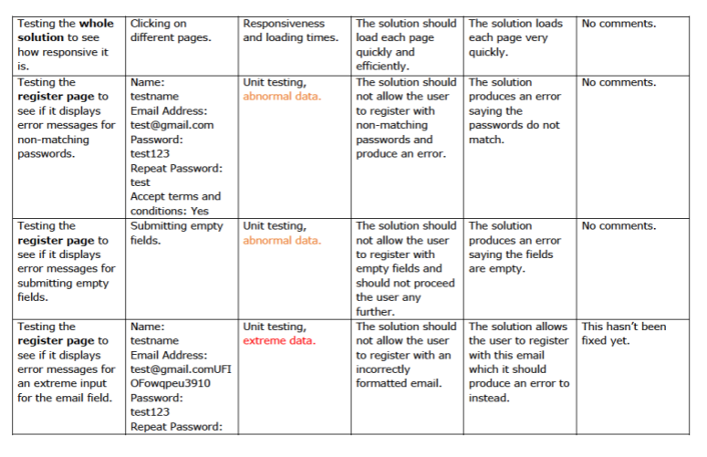
Which one is the strongest submission?
Test Log 1
Test Log2

Slide 3
Test Log 1: Weaker example
In this weaker example, it was evident that the leaner leaned heavily on the Integrated Development Environment (IDE) to spot syntactic errors, but their efforts often halted at this point.
This over-reliance on the IDE led to a superficial engagement with the code, limiting their ability to identify or rectify deeper functional issues.
They didn’t display an awareness of the broader functionality of the code, such as testing inputs and outputs and the integral role of validation and verification processes in assuring the codes functionality. The absence of this critical understanding stunted their ability to maintain a clear record of the actions undertaken to address the issues they encountered.

Slide 4
Test Log 2: Strong example
In the good example below, the student has shown exceptional competence in software testing, earning a Distinction for their work on the health information system. This proficiency is displayed in their selection of tests, their ability to identify and rectify problems, and their use of an effective iterative development process.
Their chosen tests show a thorough and detailed understanding of effectively testing the system’s inputs, calculations, validations, and processes. They’ve intelligently employed different types of test data- normal data to ensure the system functions appropriately under usual conditions, erroneous data to check the system’s resilience and error-handling capabilities, and extreme data to validate the system’s behaviour under unusual or stressful situations.
The student’s comments fully understand how they identified and rectified issues. This is evident in their handling of inputs, where they’ve shown a deep understanding of both expected and unexpected user inputs. They’ve exhibited excellent debugging skills for calculations, ensuring that the application’s logic always provides accurate results.
Validation and processes have shown the ability to rectify errors, guaranteeing that the application checks data integrity and correctly follows the intended operational procedures.

